Slide 1
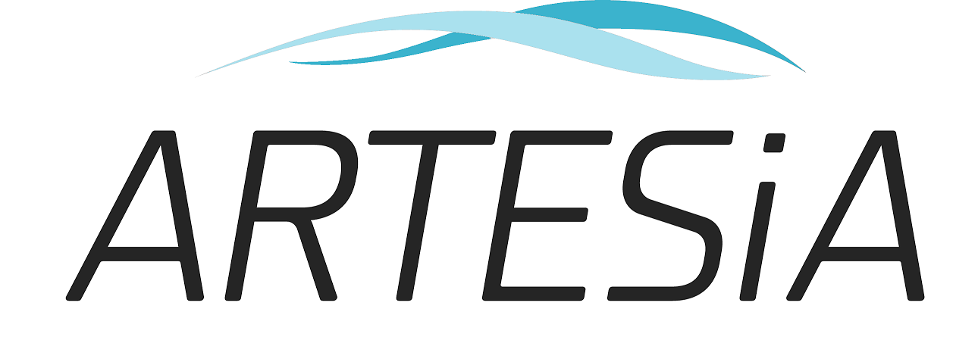
Study Background and Rationale Updated October 24, 2018
Apixaban for the Reduction of Thrombo-Embolism in Device-Detected Sub-Clinical Atrial Fibrillation

Slide 2
Apixaban for the Reduction of Thrombo-Embolism in Device-Detected Sub-Clinical Atrial Fibrillation
Management of Subclinical Atrial Fibrillation (SCAF)
What is SCAF?
How is it different than clinical AF?

Slide 3
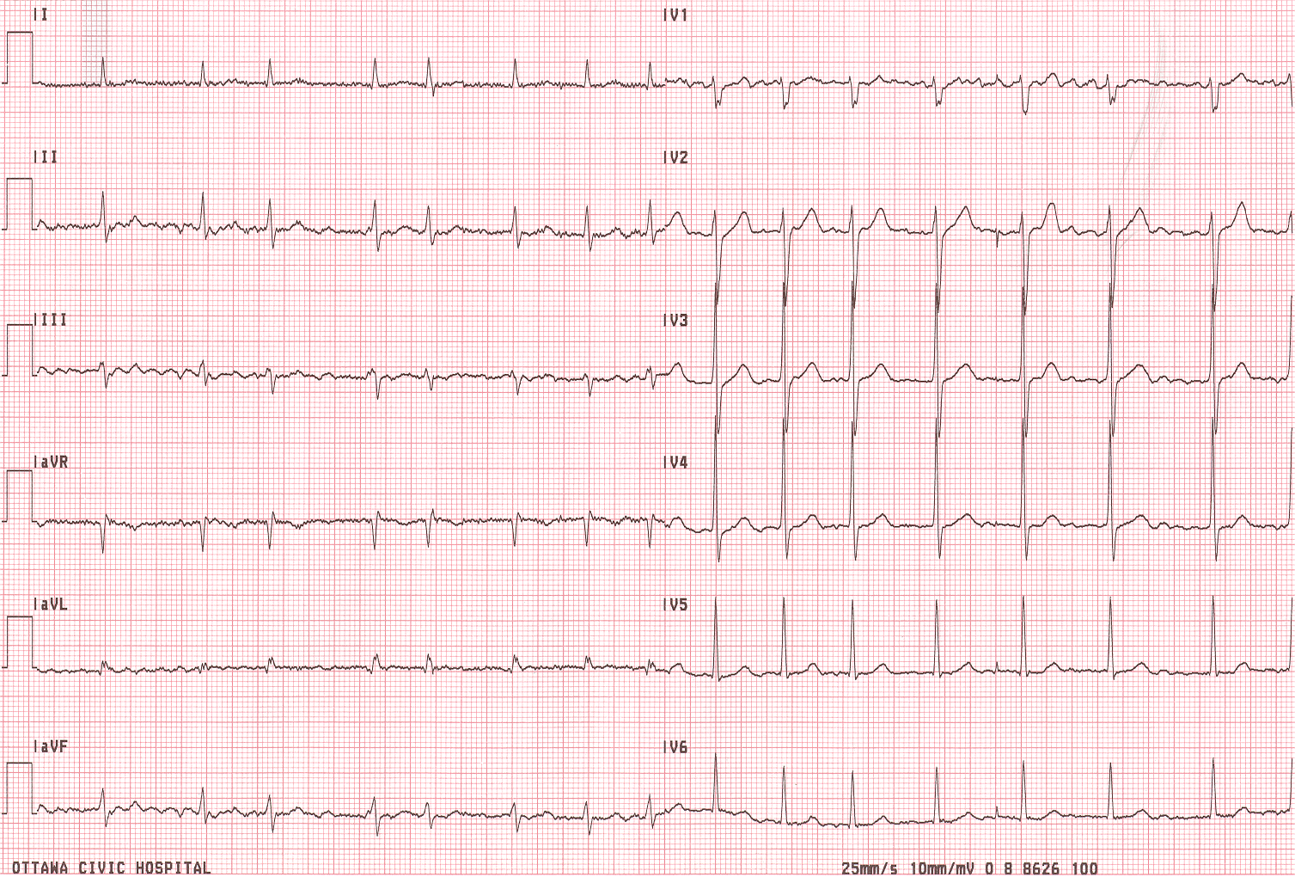
What is Atrial Fibrillation?
Cohort studies such as Framingham performed 12-lead ECG 1-2/year
70-80% of patients in RCTs of anticoagulation had persistent or permanent AF (those with paroxysmal had to have high burden)

Slide 4
SubClinical Atrial Fibrillation Detected by Cardiac Devices
SCAF is a variant of clinical AF but differs in that SCAF:
would not be detected by means other than an implanted device with continuous (24/7) long-term recording
is often asymptomatic; episodes short in duration (minutes to hours)

Slide 5
ASSERT, NEJM 2012 Atrial Tachyarrhythmia > 6 min, >190 bpm
ASSERT : Time to Adjudicated AHRE(>6 minutes,>190/minute)
# at Risk
Year 0.5
1.0
1.5
2.0
2.5
3.0
3.5
4.0
0.6
2580
2059
1842
1663
1371
1008
706
446
243
SCAF is VERY
Common in the
Pacemaker/ICD
Populations
0.5
0.4
Cumulative Hazard Rates
0.3
3 month
Visit
0.2
0.1
0.0
0
0.5
1.0
1.5
2.0
2.5
3.0
3.5
4.0
Years of Follow-up

Slide 6
ASSERT: Clinical Outcomes Healey JS, NEJM 2012
Event | Device-Detected Atrial Tachyarrhythmia |  |  |  | Device-Detected Atrial Tachyarrhythmia Present vs. absent
 | Absent N=2319 |  | Present N= 261
 | events | %/year | events | %/ year | RR | 95% CI | p
Ischemic Stroke or Systemic Embolism | 40 | 0.69 | 11 | 1.69 | 2.49 | 1.28 – 4.85 | 0.007
Vascular Death | 153 | 2.62 | 19 | 2.92 | 1.11 | 0.69 – 1.79 | 0.67
Stroke / MI / Vascular Death | 206 | 3.53 | 29 | 4.45 | 1.25 | 0.85 – 1.84 | 0.27
Clinical Atrial Fibrillation or Flutter | 71 | 1.22 | 41 | 6.29 | 5.56 | 3.78 – 8.17 | <0.001
Both absolute and relative risks of stroke with SCAF are lower than with clinical AF

Slide 7
Stroke Risk for SCAF is Lower than AF
≥
Annual stroke risk (%/yr)
¹
¹
²
¹Healey JS et al. N Engl J Med. 2012;366:120–9
²Gage BF et al. JAMA. 2001;285:2864–70

Slide 8
Subclinical AF has lower stroke risk than clinical AF

Slide 9
TRENDS: SCAF burden and stroke?
2.4%
AT/AF burden | HR for TE high vs zero burden
Low <5.5 h | 0.98 [0.34, 2.82]
High ≥5.5 h | 2.20 [0.96, 5.05]
1.1%
1.1%
AT/AF burden subset
Glötzer TV et al. Circulation Arrhyth Electrophys 2009;2:474–80.

Slide 10
Risk of Stroke/SE According to Duration of SCAF
Stroke risk in
ASSERT
is seen mostly for
patients
With SCAF lasting
>24 hours. In them,
the risk is approx.
5% per year – similar
to clinical AF
0.20
No SCAF
6mins~6hrs
6hrs~24hrs
0.15
>24hrs
Cumulative event rates
0.10
0.05
0.0
0
0.5
1
1.5
2
2.5
3
3.5
No. at Risk
Years of Follow-up
No SCAF
2455
1926
1708
1528
1251
900
624
390
6mins~6hrs
0
226
302
347
322
281
218
155
6hrs~24hrs
0
88
104
103
108
93
80
52
>24hrs
0
91
124
144
140
126
116
85
ASSERT; van Gelder IC, Eur Heart J 2017

Slide 11
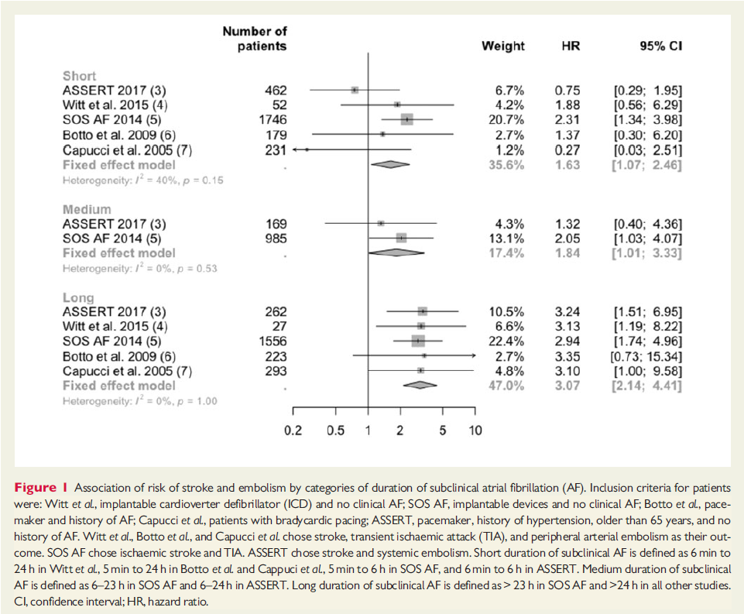
Meta-Analysis of SCAF Duration and Stroke Risk: Rahimi Eur Heart J 2017
Unclear, and low
risk of stroke for
SCAF of short and
medium duration

Slide 12
Only longer-lasting, higher-burden sub-clinical AF appears to increase stroke risk

Slide 13
Bleeding Complications with OAC
 | Major Bleeding | Fatal Bleeding
ACTIVE-W Warfarin | 2.2%/year | 0.26%/year
ARISTOTLE Warfarin Apixaban | 3.1%/year 2.1%/year | 0.34%/year 0.2%/year
RE-LY Warfarin Dabigatran – 150 BID | 3.4%/year 3.1%/year
ROCKET-AF Warfarin Rivaroxaban | 3.4%/year 3.6%/year | 0.5%/year 0.2%/year
….and pacemaker patients are older

Slide 14
Age and Major Bleeding Risk: AVERROES KH Ng; Age and Aging 2016
 | Age < 75 years | Age ≥ 75 years
ASA | 0.7%/year | 2.2%/year
Apixaban | 0.8%/year | 2.6%/year

Slide 15
SCAF and Stroke: The Decision to Treat
Must weigh risks and benefits of NOAC therapy
Absolute stroke risk is lower than with AF
Risk of bleeding with NOAC is higher than in younger patients
Must assume that RRR for NOAC therapy is the same as for AF
Which may or may not be true
Not all strokes in AF or SCAF are preventable with OAC

Slide 16
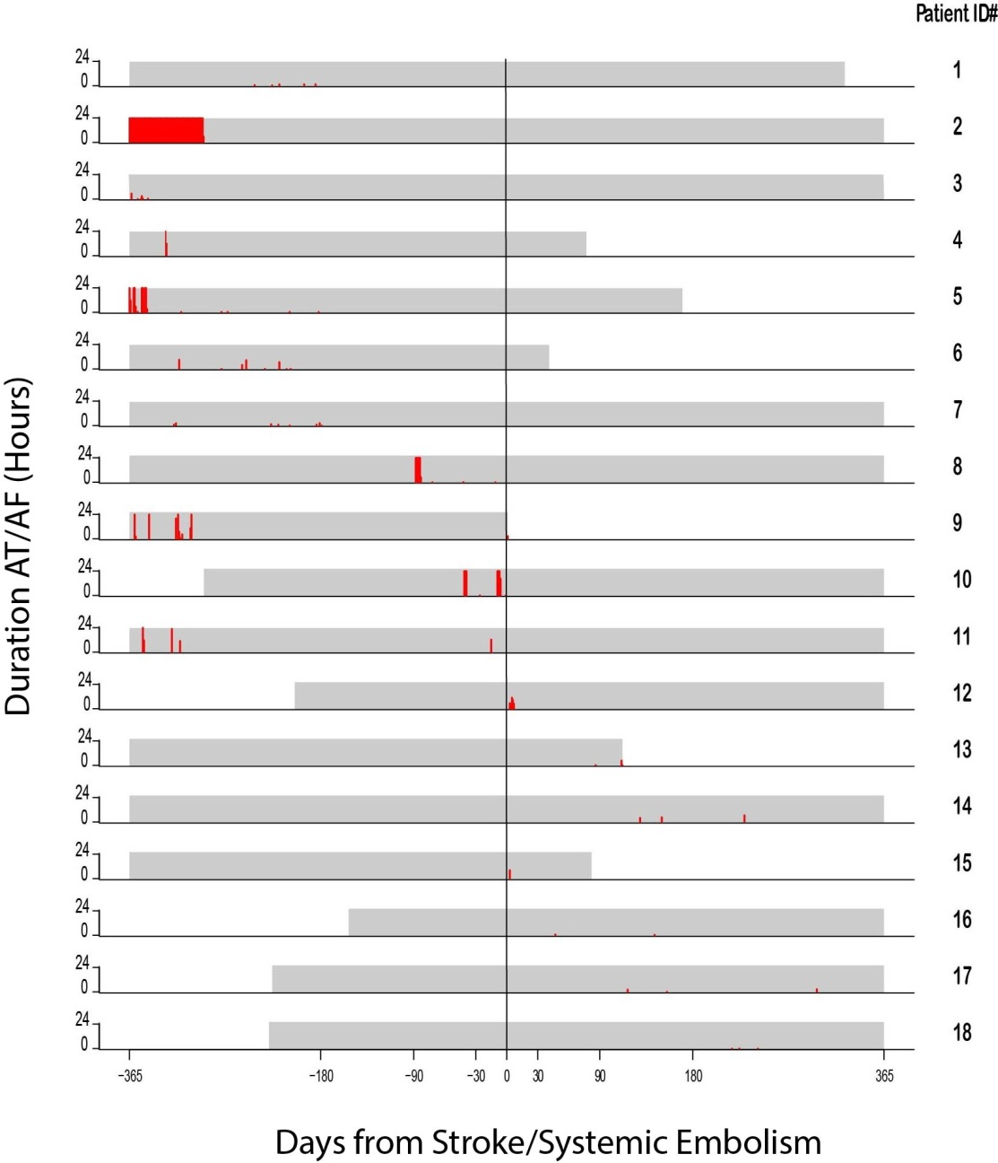
Relation between AF and Stroke
Only 15% of patients
with SCAF-associated
stroke had SCAF within
3 months of their stroke
ASSERT study
M. Brambatti
Circulation 2014

Slide 17
SCAF, Stroke Sub-Type and Severity in ASSERT
Patients with SCAF have stroke
from a variety of
mechanisms –
many of which
are not embolic

Slide 18
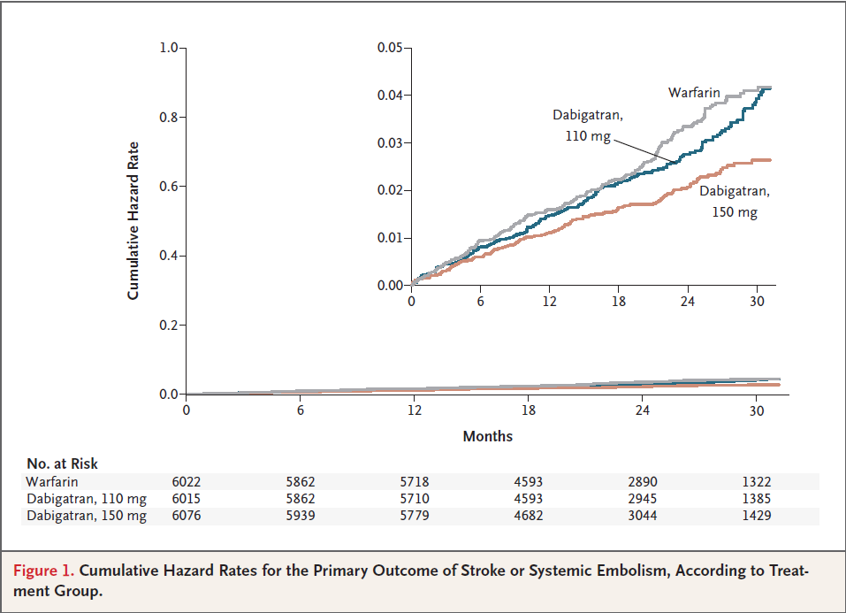
Stroke in Anticoagulated AF Patients RE-LY, Connolly SJ, NEJM 2009
Even with anticoagulation
patients with AF still have
stroke (1% per year on
Dabi 150 BID)

Slide 19
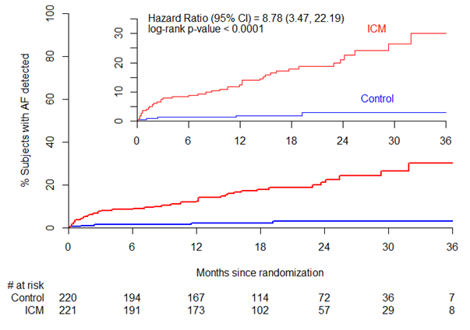
CRYPTOGENIC STROKE: CRYSTAL-AF Trial: AF R. Bernstein NEJM 2014
Rate of detection in ICM arm was 30.0% vs 3.0% in control arm
Notes:
Fix the picture

Slide 20
NAVIGATE-ESUS Trial Design
7000 patients at 460 sites in 31 countries; 450 primary events;
expected event rate 3.8%/yr
Prospective, randomized, double-blind, active-comparator, event-driven, superiority, phase III study
Patients with recent ischemic stroke and
visualized by brain CT or MRI that is not lacunar (subcortical infarct ≤1.5 cm)
absence of cervical carotid atherosclerotic artery stenosis > 50% or occlusion
no atrial fibrillation after ≥ 24 hours cardiac rhythm monitoring
no intra-cardiac thrombus on transthoracic echocardiography
no other specific etiology for cause of stroke (eg, arteritis, dissection, migraine/ vasospasm, drug abuse)
Age ≥ 50 years
~460 sites in 31 countries
Target RRR 30%; superiority w/ 90% power α=0.05
Enrollment ~24 months; minimum treatment ~6 months; study duration ~36 months Estimated mean treatment duration 6 - 24 months;
N ~7,000
Rivaroxaban 15 mg od n ~ 3,500
1 month post study drug observation period
R
ASA 100 mg od n ~ 3,500
Day 1
Efficacy Cut-off Date
30±7 days
EOS
Randomization
Randomization 7 days to 6 month after acute ESUS
October 2017: Study stopped early for futility
Comparable efficacy between rivaroxaban and aspirin
Increased bleeding in rivaroxaban arm (though overall rates were low)

Slide 21
What do the NAVIGATE-ESUS results mean for ARTESiA?
Bias towards anticoagulating patients with prior stroke and SCAF may change… more equipoise
Previous Stroke or TIA + SCAF = eligible for ARTESiA
ARTESiA Baseline Data:
as of Sep.19, 2018
N = 1935
History of:
Stroke | 4.1%
TIA | 4.6%

Slide 22
Sub-Clinical AF: Beyond the Pacemaker Population

Slide 23
ASSERT-II
Patients, without prior AF, attending cardiology/neurology outpatient clinics
St. Jude Medical Confirm (DM2100) loop recorder implanted with at least 9 months follow up
Primary outcome of SCAF ≥ 5 minutes in duration

Slide 24
Detailed Inclusion Criteria
Age ≥ 65
and
One of :
-CHA₂DS₂-VASc ≥ 2
-Obstructive sleep apnea
-BMI >30
and
One of :
-Left atrial volume ≥ 58ml or LA diameter ≥ 4.4cm
-Serum NT-ProBNP ≥ 290 pg/mL

Slide 25
Patient Characteristics (N=256)
Age, mean±SD | 73.85±6.24
Female, n(%) | 88 (34.4)
Caucasian, n(%) | 246 (96.1)
History of Hypertension, n(%) | 188 (73.4)
Heart failure, n(%) | 22 (8.6)
Diabetes, n(%) | 64 (25.0)
Prior stroke, TIA or SE, n(%) | 123 (48.0)
Sleep Apnea, n(%) | 29 (11.3)
BMI | 28.69±4.64
Valvular Heart Disease, n(%) | 37 (14.5)
CHA₂DS₂-VASc, mean±SD | 4.14±1.36
LA diameter (cm), mean±SD | 4.74±0.79
LA volume (ml), mean±SD | 76.53±20.61

Slide 26
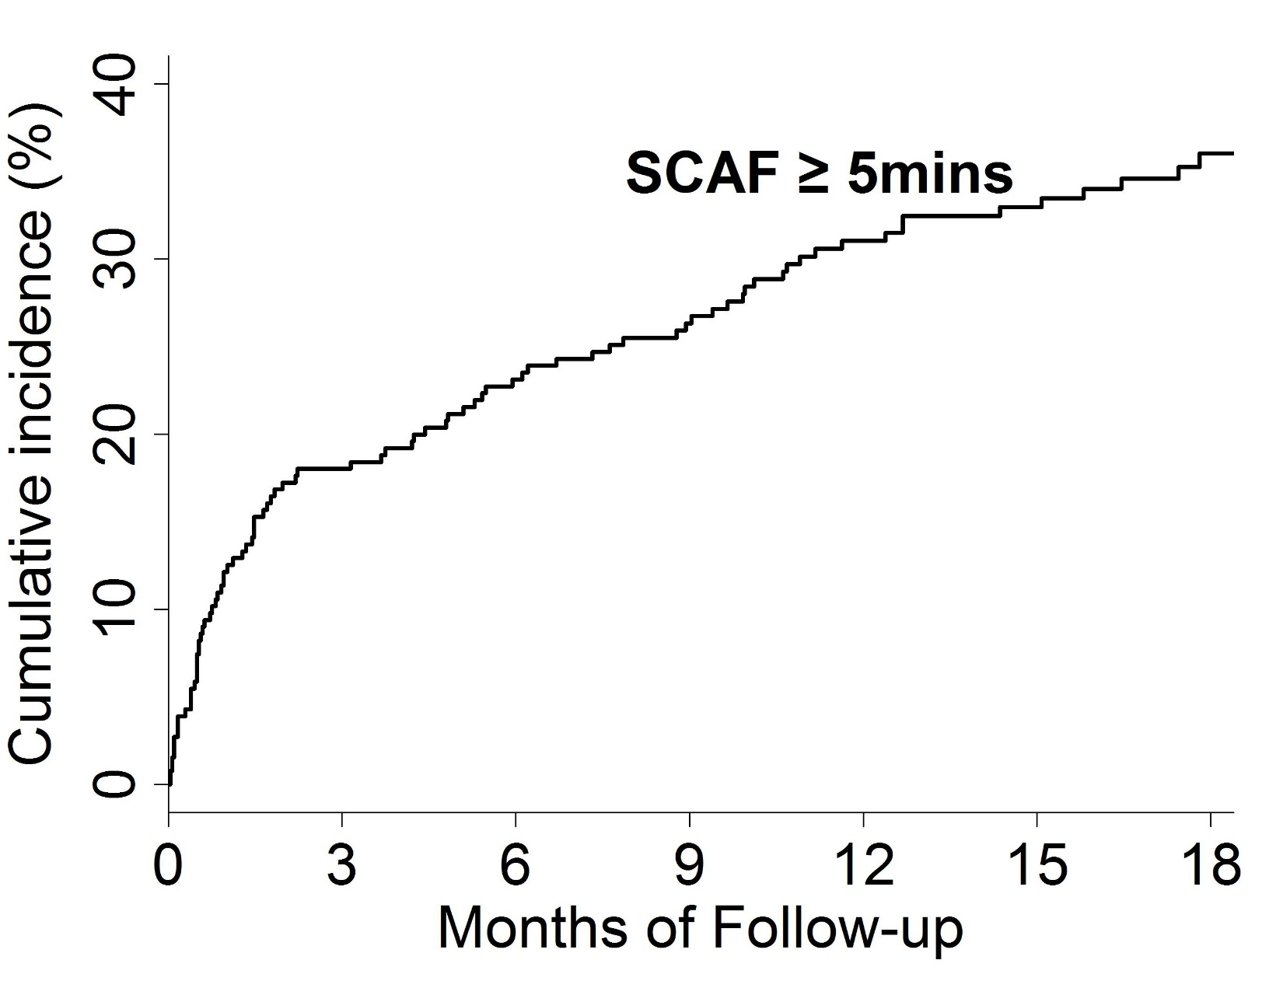
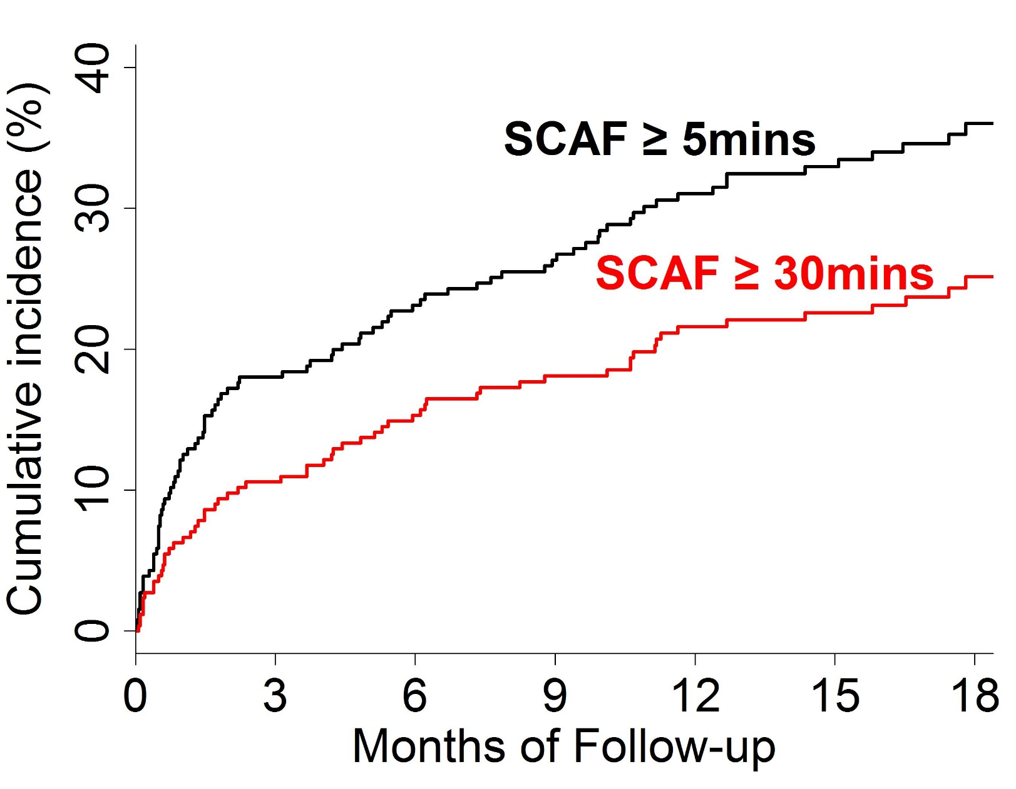
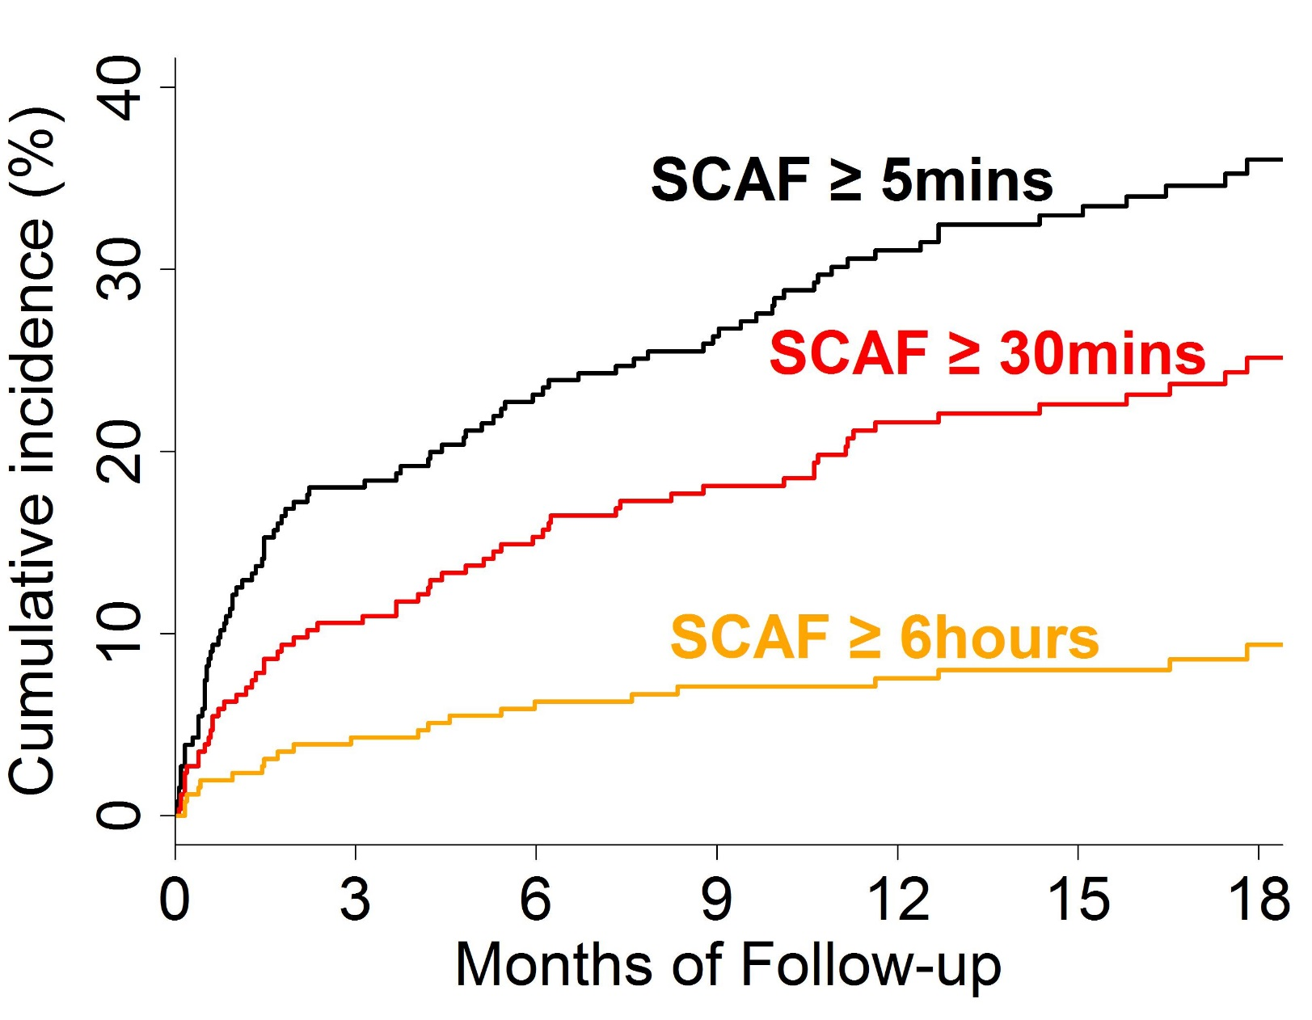
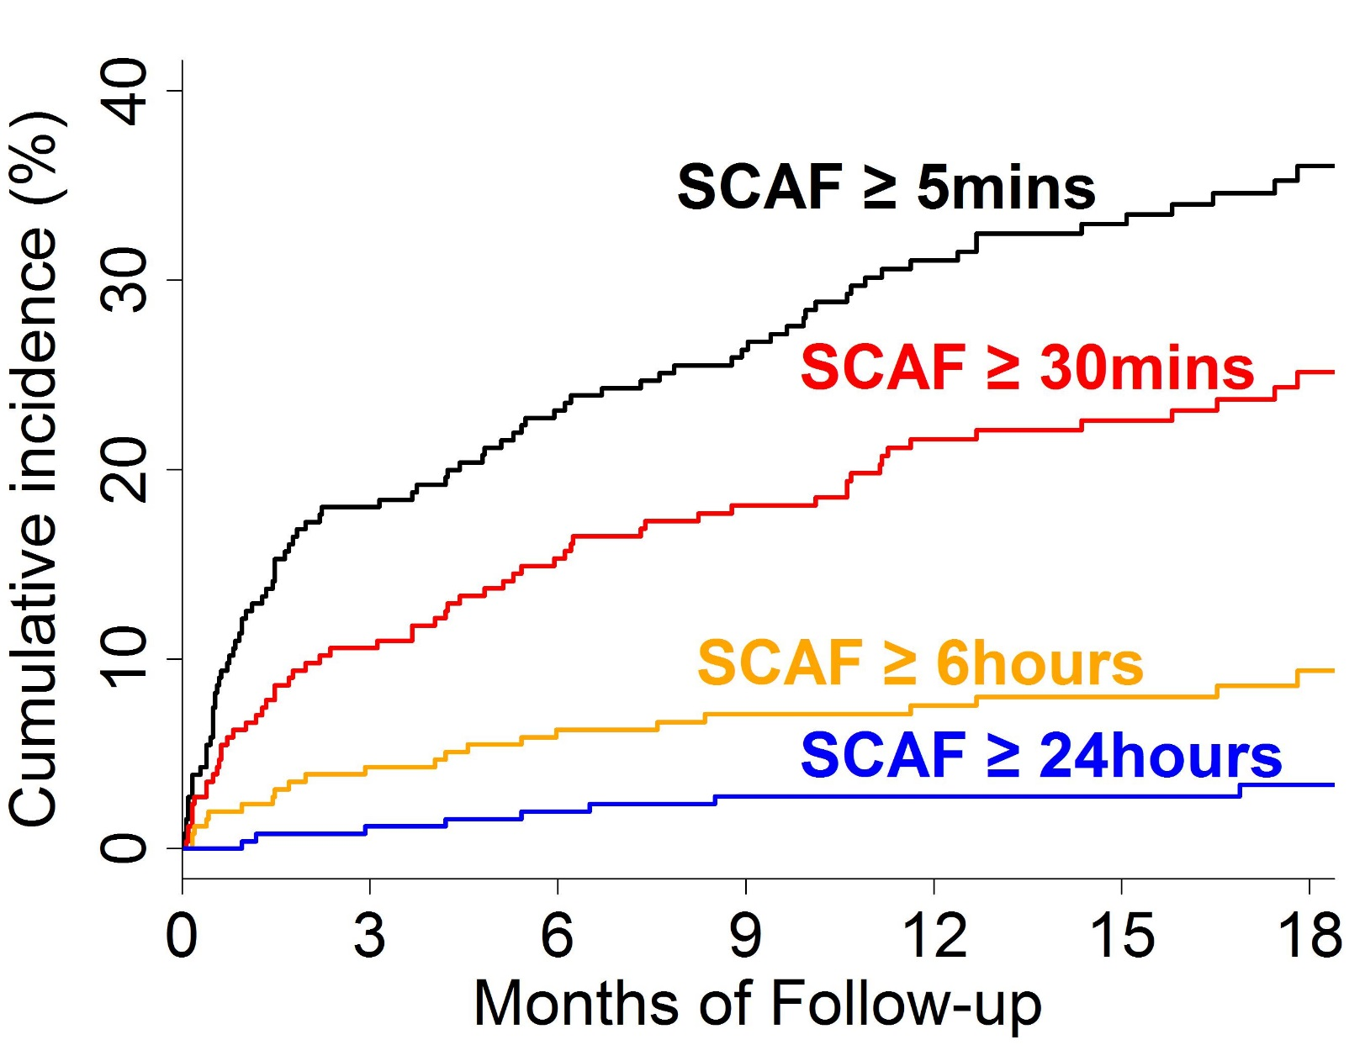
Incidence of SCAF
Rate per year (95% CI)
34.4% (27.7% – 42.3%)
21.8% (16.7% – 27.8%)
7.1% (4.5% – 10.6%)
2.7% (1.2% – 5.0%)

Slide 27
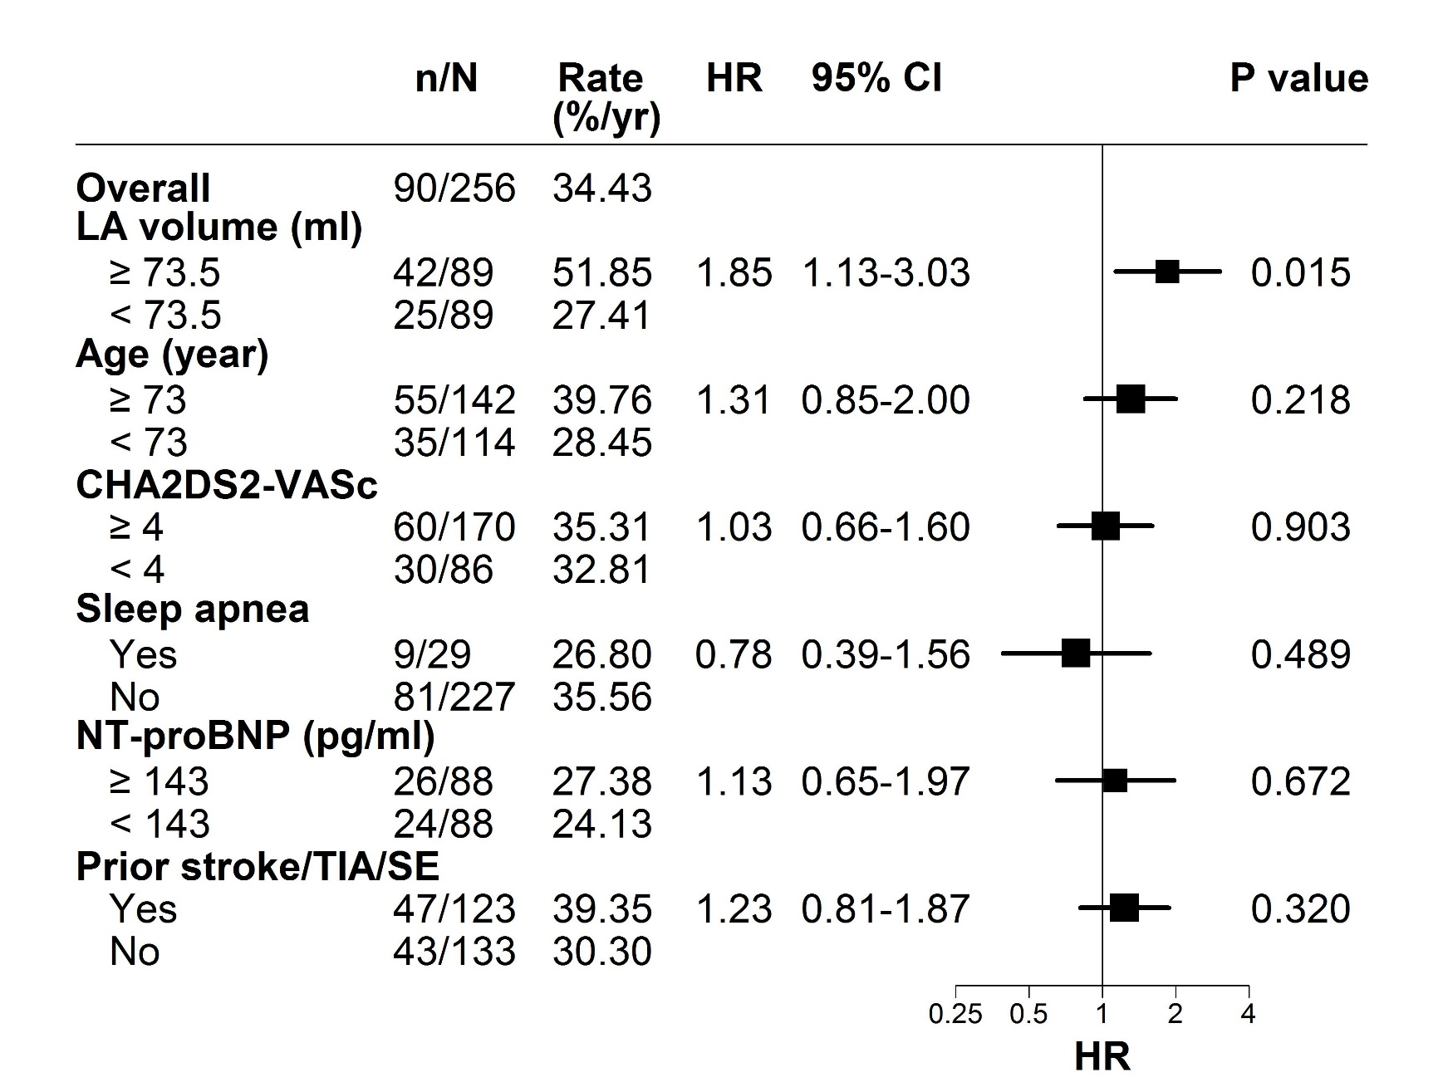
SCAF ≥ 5 Minutes by Sub-Group

Slide 28
Conclusions of ASSERT-II
SCAF is VERY common in older individuals with cardiovascular conditions but without a pacemaker/ICD
Need to determine how to treat SCAF in pacemaker/ICD patients today, as it has major implications for the more general population!

